Slide 1
Nearshore Sediment Transport Final Project – Part 3 Formula Tree Diagram
Prepared by Jacob Plumb

Slide 2
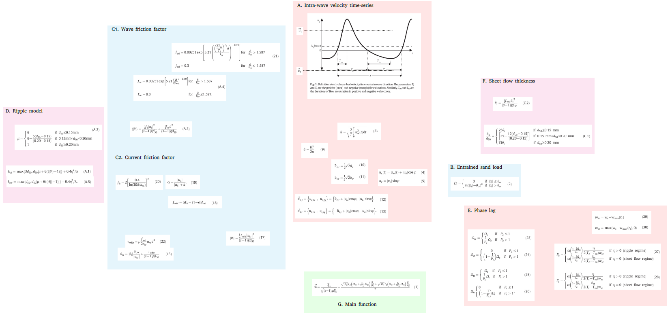

$$c_{w}=\frac{L}{T}$$

Slide 3
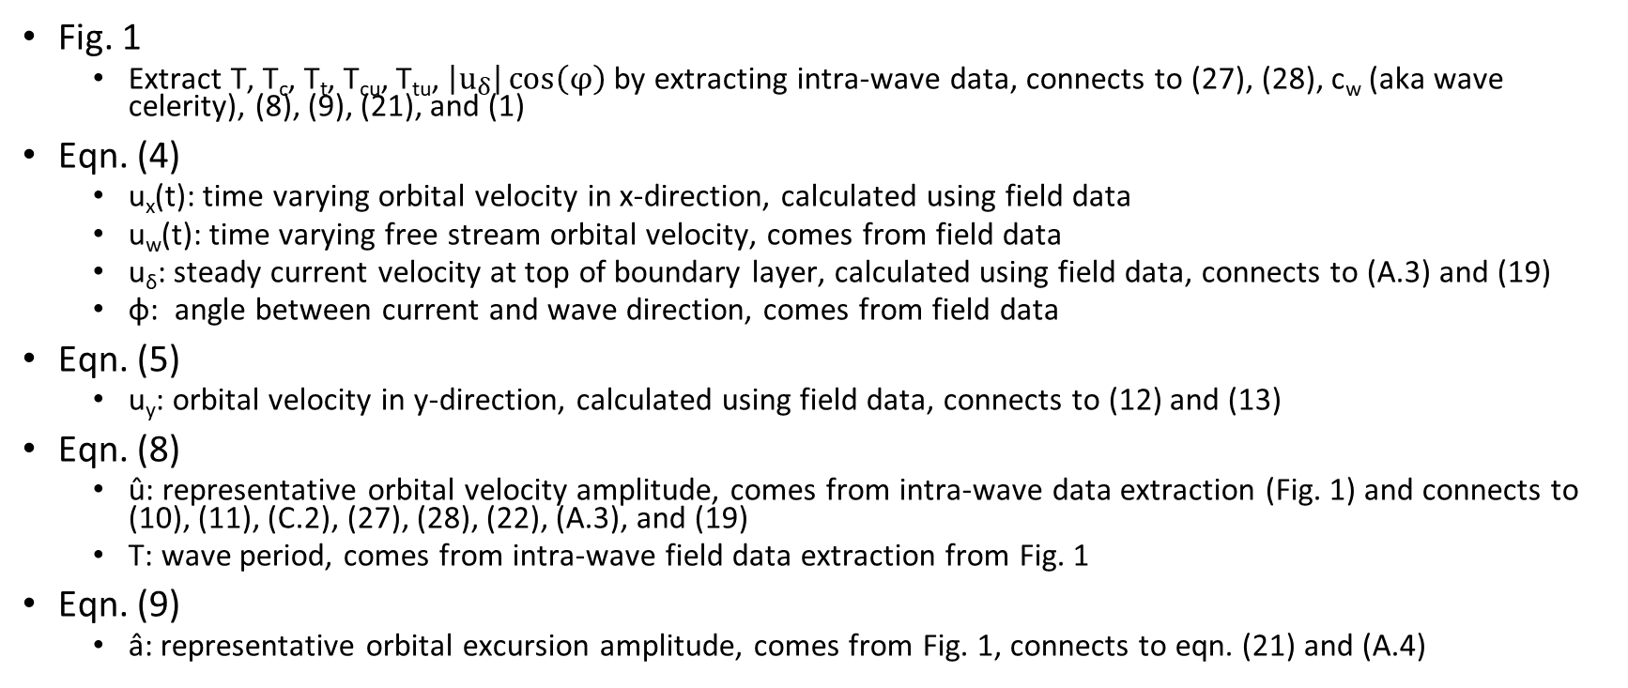
Variables within each formula
Fig. 1
Extract T, T_{c}, T_{t}, T_{cu}, T_{tu}, $\left|u_{δ}\right|\cos\left(φ\right)$ by extracting intra-wave data, connects to (27), (28), c_{w} (aka wave celerity), (8), (9), (21), and (1)
Eqn. (4)
u_{x}(t): time varying orbital velocity in x-direction, calculated using field data
u_{w}(t): time varying free stream orbital velocity, comes from field data
u_{δ}: steady current velocity at top of boundary layer, calculated using field data, connects to (A.3) and (19)
φ: angle between current and wave direction, comes from field data
Eqn. (5)
u_{y}: orbital velocity in y-direction, calculated using field data, connects to (12) and (13)
Eqn. (8)
û: representative orbital velocity amplitude, comes from intra-wave data extraction (Fig. 1) and connects to (10), (11), (C.2), (27), (28), (22), (A.3), and (19)
T: wave period, comes from intra-wave field data extraction from Fig. 1
Eqn. (9)
â̂: representative orbital excursion amplitude, comes from Fig. 1, connects to eqn. (21) and (A.4)

Slide 4
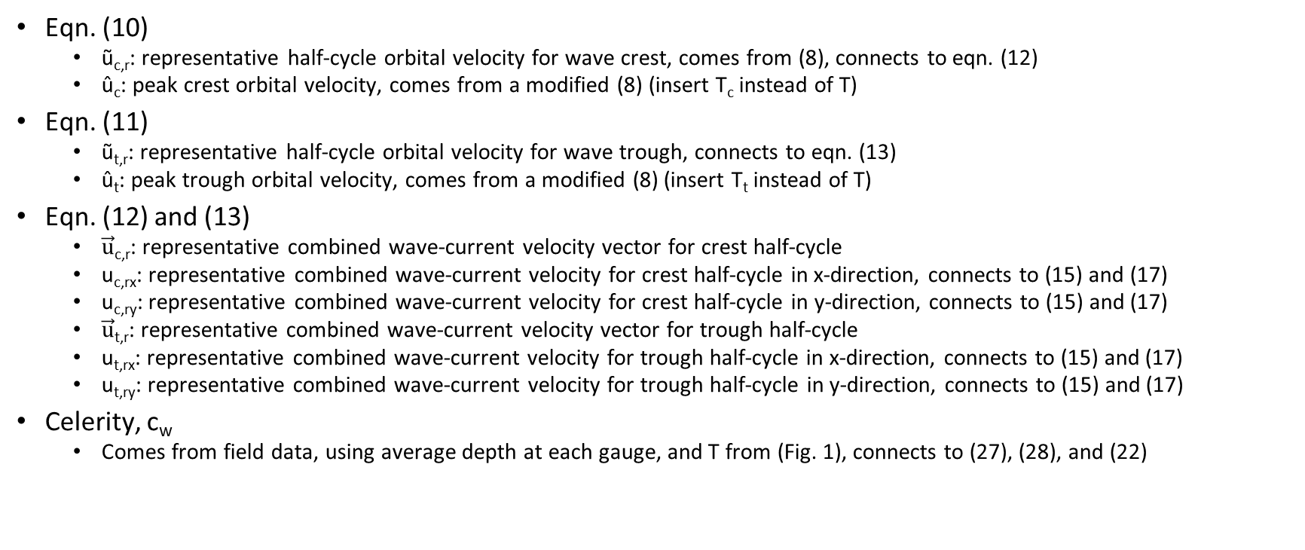
Variables within each formula, continued…
Eqn. (10)
ũ_{c,r}: representative half-cycle orbital velocity for wave crest, comes from (8), connects to eqn. (12)
û_{c}: peak crest orbital velocity, comes from a modified (8) (insert T_{c} instead of T)
Eqn. (11)
ũ_{t,r}: representative half-cycle orbital velocity for wave trough, connects to eqn. (13)
û_{t}: peak trough orbital velocity, comes from a modified (8) (insert T_{t} instead of T)
Eqn. (12) and (13)
$\vec{u}$_{c,r}: representative combined wave-current velocity vector for crest half-cycle
u_{c,rx}: representative combined wave-current velocity for crest half-cycle in x-direction, connects to (15) and (17)
u_{c,ry}: representative combined wave-current velocity for crest half-cycle in y-direction, connects to (15) and (17)
$\vec{u}$_{t,r}: representative combined wave-current velocity vector for trough half-cycle
u_{t,rx}: representative combined wave-current velocity for trough half-cycle in x-direction, connects to (15) and (17)
u_{t,ry}: representative combined wave-current velocity for trough half-cycle in y-direction, connects to (15) and (17)
Celerity, c_{w}
Comes from field data, using average depth at each gauge, and T from (Fig. 1), connects to (27), (28), and (22)

